Slide 1

Supervised Stock Price Prediction using Long-Short Term Memory and Technical Indicators Final Dissertation Presentation Finn Zhan Chen – 30th April 2019 Supervised by Shay Cohen
Notes:
15 mins total and

Slide 2
Structure
Problem
Challenge
Use Cases
Solution
Result
Persistence Baseline models
Other Benchmark models
Future Work

Slide 3
Problem
Stock Prediction is Hard
There are many approaches such as technical, fundamental, and sentiment analysis. This dissertation focuses on building LSTM models based on technical analysis
Costly Advisory Service
Expensive to access industry experts and premium services for stock advices and recommendations
Big Data
A lot new data are becoming readily available to public. How can these be effectively used to predict stock prices?
High Value Domain
A single wrong investment could lead to huge losses or not getting the most out of the investment

Slide 4
Challenge
Data Collection
What data are freely available?
52 time series of daily technical indicators for 100 companies in Nasdaq 100 and others were collected offline
Preprocessing
How do different preprocessing techniques affect performance?
Time series were transformed into standard scaled, stationary, supervised learning time series
Parameter Optimisation
What is the optimal combination of parameters?
Experiments were set up to find the optimal combinations to beat the performance of baseline and benchmark models
Evaluation
How to evaluate against other baseline and benchmark models?
Same entity (company, index, or cryptocurrency), training and testing period were used for comparison

Slide 5
Use Cases
Stock Prediction
LSTM prediction models were built:
To assist the author in buying and selling stocks in his portfolio.
To generate additional profit from the investment that would otherwise have not been possible.
To bypass costly financial advisory services
Automatic trading
Platforms allow individuals to trade easily, so future works could be:
To use platform API to automate real time trading based on user’s risk profile (Future Work)
To build a virtual trading simulation game to estimate profit returns using past or real time data.

Slide 6
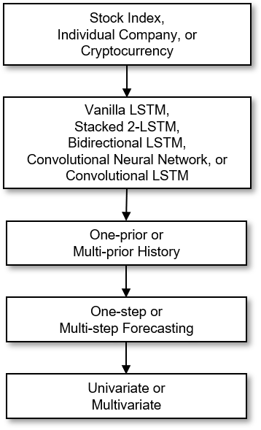
Solution
A system to build models with different parameters
Experiments were set up to find how combination of the following impact performance using collected Nasdaq 100 companies in terms performance:
model types
n-prior history
n-step forecasting
n-variate
The end goal is to find the best models to beat baseline and benchmark models from other research papers.

Slide 7
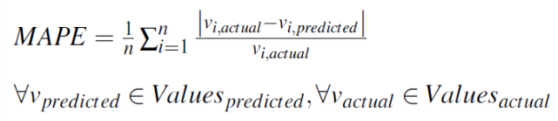
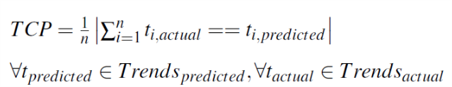
Results: Metrics
2 evaluative metrics were:
Mean Absolute Percentage Error (MAPE)
Trend Correct Percentage (TCP)

Slide 8
Persistence Baseline Models
Results: Baseline

Slide 9
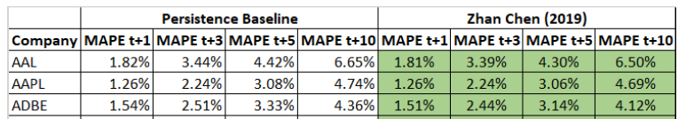
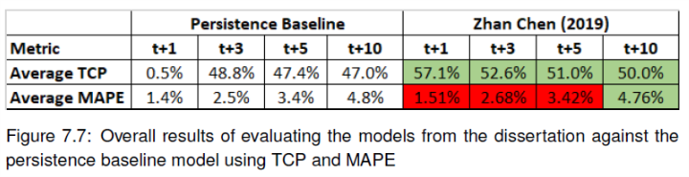
Persistence Baseline Models 100 models for 100 Nasdaq companies with the best parameters (from experiments) resulted on average:
Results: Baseline

Slide 10
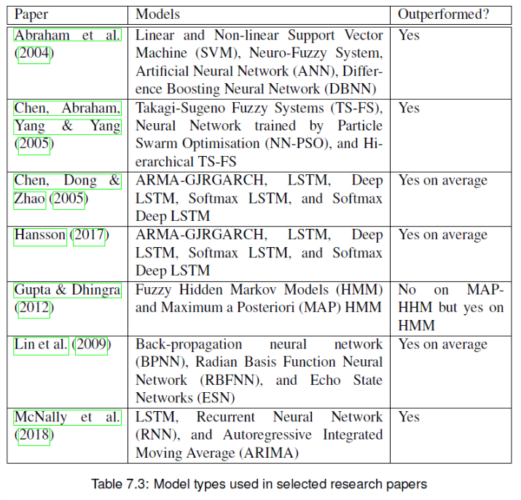
Results: Benchmark

Slide 11
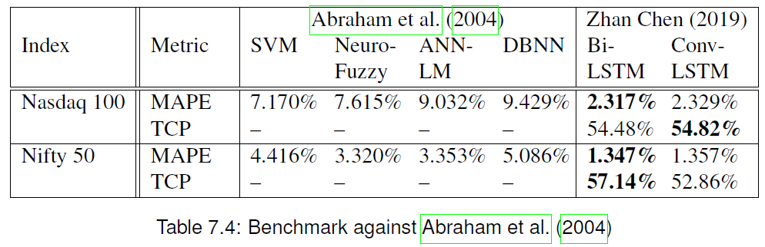
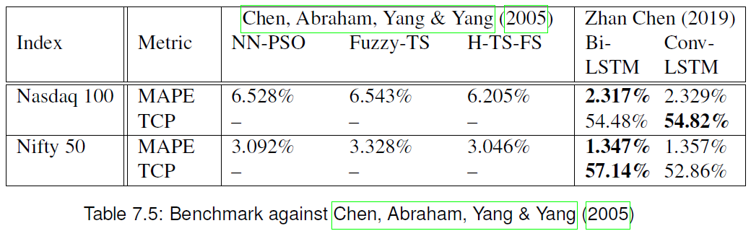
Results: Benchmark

Slide 12
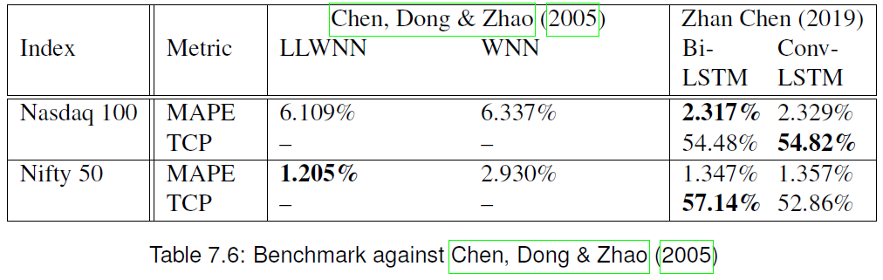
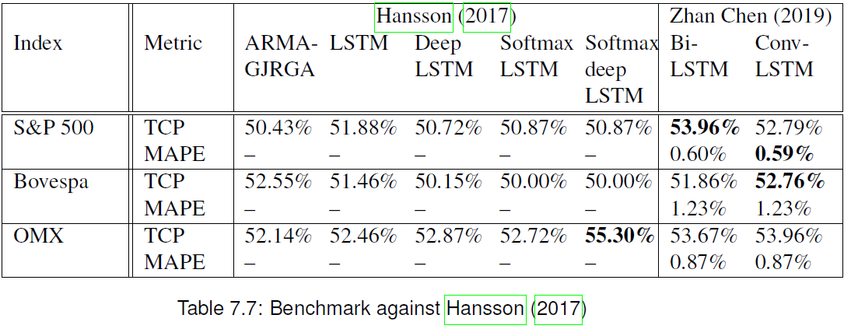
Results: Benchmark

Slide 13
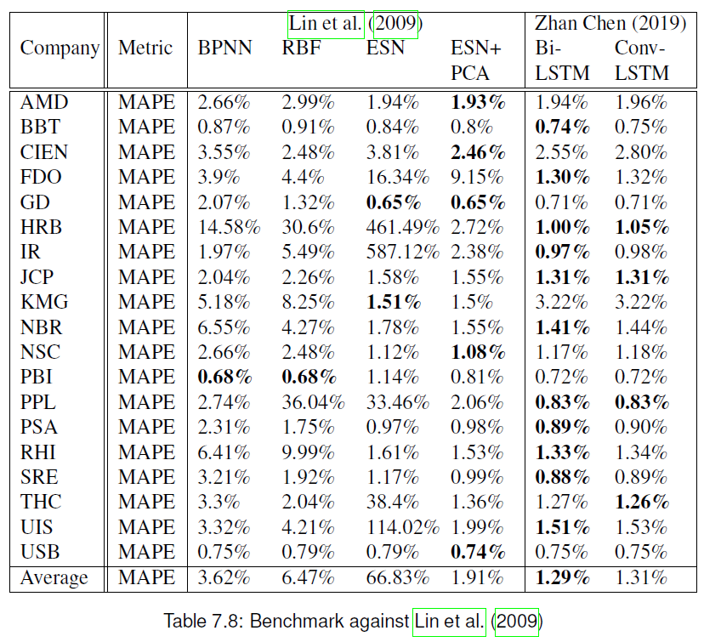
Results: Benchmark

Slide 14
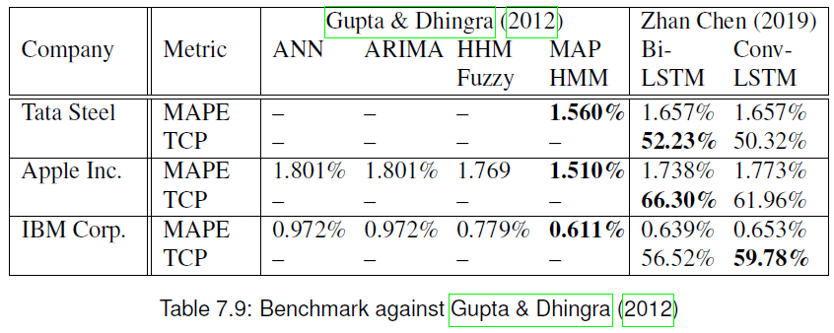
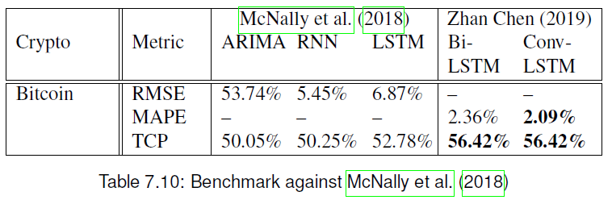
Results: Benchmark

Slide 15
Conclusion
Outcome
Bidirectional and convolutional LSTM models have:
significantly beaten the persistence baseline model against 100 companies in Nasdaq 100 in terms of TCP (Trend Correct Percentage)
outperformed 6 out of 7 selected papers in the same domain of predicting stock price values and trends based on technical analysis
Future Work
Future works may include:
using platform API to automate real time trading based on user’s risk profile
building a virtual trading simulation game to estimate profit returns using past or real time data.

Slide 16
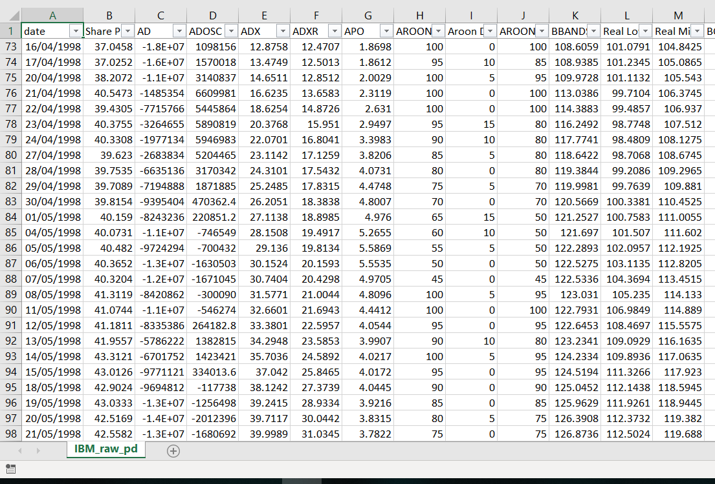
Backup: Data

